Slide 1
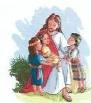

A Special Mass
For All of
God’s Special Children
Sunday , October 14, 2012
2:30 p.m.
The Parish of St. Joseph-St.Thomas welcomes all children with special needs and their families and friends to a Mass at:
St. Thomas Church
50 Maguire Avenue
Staten Island NY 10309
Next Mass: November 11, 2012
Questions? Need directions?
Dietary Concerns?
Call 718-984-1156
Email:sjstchildofGod@gmail.com
Low Gluten Altar Breads Available
(Less than .01 Gluten Content)
Notes:
Sunday October 14, 2012
2:30 p.m.

